Slide 1



Deep diving in Spring Security
with the latest trends and additions

Slide 2

Notes:
Elements (version 1)
Elements are used to give more detail to a set of ideas, they should all relate to the same topic.
For example, use this page for a list of deliverables, key roles on a project, phases of a project, or any topic that can be broken down into more specific examples.
Each section should have an icon that relates to the content of that specific element, no icon should be repeated on the same page, and they should all be the same colour.
Keep the text to 1-2 sentences and aim to have about the same amount of content under each element.

Slide 3
https://github.com/lspil/devoxxbe2023
Notes:
Elements (version 1)
Elements are used to give more detail to a set of ideas, they should all relate to the same topic.
For example, use this page for a list of deliverables, key roles on a project, phases of a project, or any topic that can be broken down into more specific examples.
Each section should have an icon that relates to the content of that specific element, no icon should be repeated on the same page, and they should all be the same colour.
Keep the text to 1-2 sentences and aim to have about the same amount of content under each element.

Slide 4








laurspilca.com/blog
youtube.com/c/laurentiuspilca
@laurspilca
Laurentiu Spilca
Notes:
Elements (version 1)
Elements are used to give more detail to a set of ideas, they should all relate to the same topic.
For example, use this page for a list of deliverables, key roles on a project, phases of a project, or any topic that can be broken down into more specific examples.
Each section should have an icon that relates to the content of that specific element, no icon should be repeated on the same page, and they should all be the same colour.
Keep the text to 1-2 sentences and aim to have about the same amount of content under each element.

Slide 5

Spring Security
Notes:
Elements (version 1)
Elements are used to give more detail to a set of ideas, they should all relate to the same topic.
For example, use this page for a list of deliverables, key roles on a project, phases of a project, or any topic that can be broken down into more specific examples.
Each section should have an icon that relates to the content of that specific element, no icon should be repeated on the same page, and they should all be the same colour.
Keep the text to 1-2 sentences and aim to have about the same amount of content under each element.

Slide 6
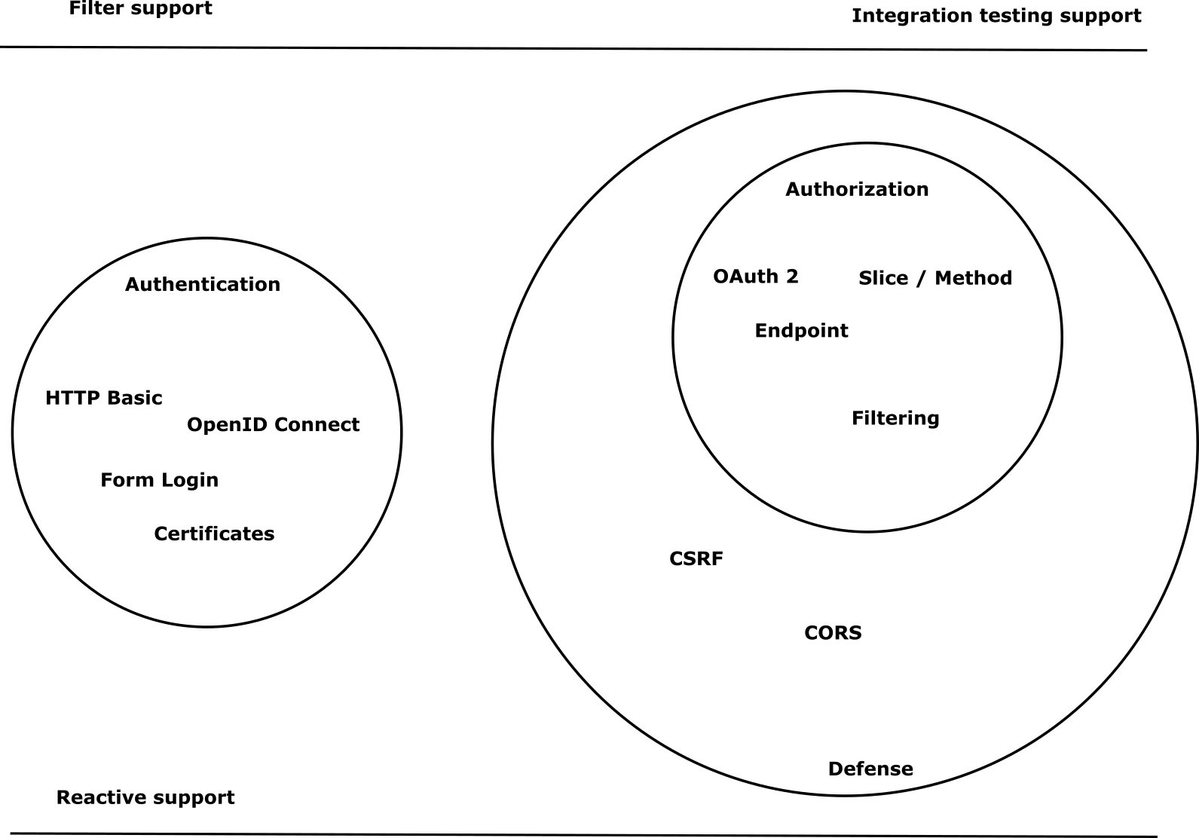
Notes:
Elements (version 1)
Elements are used to give more detail to a set of ideas, they should all relate to the same topic.
For example, use this page for a list of deliverables, key roles on a project, phases of a project, or any topic that can be broken down into more specific examples.
Each section should have an icon that relates to the content of that specific element, no icon should be repeated on the same page, and they should all be the same colour.
Keep the text to 1-2 sentences and aim to have about the same amount of content under each element.

Slide 7

Latest changes
Notes:
Elements (version 1)
Elements are used to give more detail to a set of ideas, they should all relate to the same topic.
For example, use this page for a list of deliverables, key roles on a project, phases of a project, or any topic that can be broken down into more specific examples.
Each section should have an icon that relates to the content of that specific element, no icon should be repeated on the same page, and they should all be the same colour.
Keep the text to 1-2 sentences and aim to have about the same amount of content under each element.

Slide 8
public class ProjectConfig extends WebSecurityConfigurerAdapter
public class ProjectConfig extends WebSecurityConfigurerAdapter
Notes:
Elements (version 1)
Elements are used to give more detail to a set of ideas, they should all relate to the same topic.
For example, use this page for a list of deliverables, key roles on a project, phases of a project, or any topic that can be broken down into more specific examples.
Each section should have an icon that relates to the content of that specific element, no icon should be repeated on the same page, and they should all be the same colour.
Keep the text to 1-2 sentences and aim to have about the same amount of content under each element.

Slide 9
@Override
public void configure(HttpSecurity http) {
}
@Bean
public SecurityFilterChain securityFilterChain(HttpSecurity http) {
}
Notes:
Elements (version 1)
Elements are used to give more detail to a set of ideas, they should all relate to the same topic.
For example, use this page for a list of deliverables, key roles on a project, phases of a project, or any topic that can be broken down into more specific examples.
Each section should have an icon that relates to the content of that specific element, no icon should be repeated on the same page, and they should all be the same colour.
Keep the text to 1-2 sentences and aim to have about the same amount of content under each element.

Slide 10
Improved flexibility in configuration helps for better maintainability
Decoupling helps with testability and integrability
Notes:
Elements (version 1)
Elements are used to give more detail to a set of ideas, they should all relate to the same topic.
For example, use this page for a list of deliverables, key roles on a project, phases of a project, or any topic that can be broken down into more specific examples.
Each section should have an icon that relates to the content of that specific element, no icon should be repeated on the same page, and they should all be the same colour.
Keep the text to 1-2 sentences and aim to have about the same amount of content under each element.

Slide 11
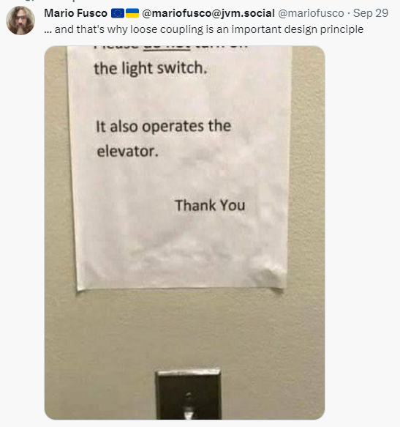
Easier to address circular
dependencies in
security configurations.
Notes:
Elements (version 1)
Elements are used to give more detail to a set of ideas, they should all relate to the same topic.
For example, use this page for a list of deliverables, key roles on a project, phases of a project, or any topic that can be broken down into more specific examples.
Each section should have an icon that relates to the content of that specific element, no icon should be repeated on the same page, and they should all be the same colour.
Keep the text to 1-2 sentences and aim to have about the same amount of content under each element.

Slide 12
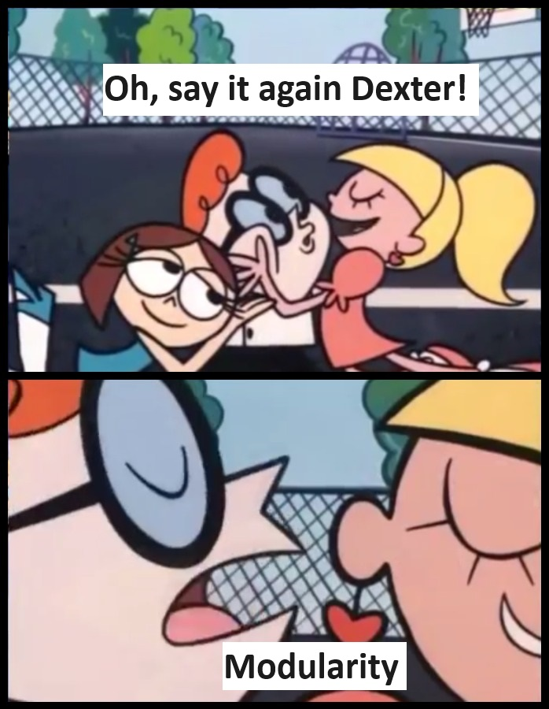
Notes:
Elements (version 1)
Elements are used to give more detail to a set of ideas, they should all relate to the same topic.
For example, use this page for a list of deliverables, key roles on a project, phases of a project, or any topic that can be broken down into more specific examples.
Each section should have an icon that relates to the content of that specific element, no icon should be repeated on the same page, and they should all be the same colour.
Keep the text to 1-2 sentences and aim to have about the same amount of content under each element.

Slide 13
@Bean
public SecurityFilterChain securityFilterChain(HttpSecurity http) { return http.build();
}
Notes:
Elements (version 1)
Elements are used to give more detail to a set of ideas, they should all relate to the same topic.
For example, use this page for a list of deliverables, key roles on a project, phases of a project, or any topic that can be broken down into more specific examples.
Each section should have an icon that relates to the content of that specific element, no icon should be repeated on the same page, and they should all be the same colour.
Keep the text to 1-2 sentences and aim to have about the same amount of content under each element.

Slide 14
@Bean
public SecurityFilterChain securityFilterChain(HttpSecurity http)
throws Exception {
http.authorizeRequests().anyRequest().authenticated();
return http.build();
}
Notes:
Elements (version 1)
Elements are used to give more detail to a set of ideas, they should all relate to the same topic.
For example, use this page for a list of deliverables, key roles on a project, phases of a project, or any topic that can be broken down into more specific examples.
Each section should have an icon that relates to the content of that specific element, no icon should be repeated on the same page, and they should all be the same colour.
Keep the text to 1-2 sentences and aim to have about the same amount of content under each element.

Slide 15
http.authorizeRequests().anyRequest().authenticated();
http.authorizeHttpRequests().anyRequest().authenticated();
Notes:
Elements (version 1)
Elements are used to give more detail to a set of ideas, they should all relate to the same topic.
For example, use this page for a list of deliverables, key roles on a project, phases of a project, or any topic that can be broken down into more specific examples.
Each section should have an icon that relates to the content of that specific element, no icon should be repeated on the same page, and they should all be the same colour.
Keep the text to 1-2 sentences and aim to have about the same amount of content under each element.

Slide 16
http.authorizeHttpRequests().anyRequest().authenticated();
http.authorizeHttpRequests(
c -> c. anyRequest().authenticated()
)
Notes:
Elements (version 1)
Elements are used to give more detail to a set of ideas, they should all relate to the same topic.
For example, use this page for a list of deliverables, key roles on a project, phases of a project, or any topic that can be broken down into more specific examples.
Each section should have an icon that relates to the content of that specific element, no icon should be repeated on the same page, and they should all be the same colour.
Keep the text to 1-2 sentences and aim to have about the same amount of content under each element.

Slide 17
antMatchers()
mvcMatchers()
regexMatchers()
requestMatchers()
Notes:
Elements (version 1)
Elements are used to give more detail to a set of ideas, they should all relate to the same topic.
For example, use this page for a list of deliverables, key roles on a project, phases of a project, or any topic that can be broken down into more specific examples.
Each section should have an icon that relates to the content of that specific element, no icon should be repeated on the same page, and they should all be the same colour.
Keep the text to 1-2 sentences and aim to have about the same amount of content under each element.

Slide 18
access(“isAuthenticated()”)
access(new WebExpressionAuthorizationManager(“isAuthenticated()”))
Notes:
Elements (version 1)
Elements are used to give more detail to a set of ideas, they should all relate to the same topic.
For example, use this page for a list of deliverables, key roles on a project, phases of a project, or any topic that can be broken down into more specific examples.
Each section should have an icon that relates to the content of that specific element, no icon should be repeated on the same page, and they should all be the same colour.
Keep the text to 1-2 sentences and aim to have about the same amount of content under each element.

Slide 19
AuthorizationManager
implements
WebExpressionAuthorizationManager
Notes:
Elements (version 1)
Elements are used to give more detail to a set of ideas, they should all relate to the same topic.
For example, use this page for a list of deliverables, key roles on a project, phases of a project, or any topic that can be broken down into more specific examples.
Each section should have an icon that relates to the content of that specific element, no icon should be repeated on the same page, and they should all be the same colour.
Keep the text to 1-2 sentences and aim to have about the same amount of content under each element.

Slide 20
@EnableGlobalMethodSecurity(prePostEnabled=true)
@EnableMethodSecurity
Notes:
Elements (version 1)
Elements are used to give more detail to a set of ideas, they should all relate to the same topic.
For example, use this page for a list of deliverables, key roles on a project, phases of a project, or any topic that can be broken down into more specific examples.
Each section should have an icon that relates to the content of that specific element, no icon should be repeated on the same page, and they should all be the same colour.
Keep the text to 1-2 sentences and aim to have about the same amount of content under each element.

Slide 21
OpenID Connect / OAuth 2
Notes:
Elements (version 1)
Elements are used to give more detail to a set of ideas, they should all relate to the same topic.
For example, use this page for a list of deliverables, key roles on a project, phases of a project, or any topic that can be broken down into more specific examples.
Each section should have an icon that relates to the content of that specific element, no icon should be repeated on the same page, and they should all be the same colour.
Keep the text to 1-2 sentences and aim to have about the same amount of content under each element.

Slide 22
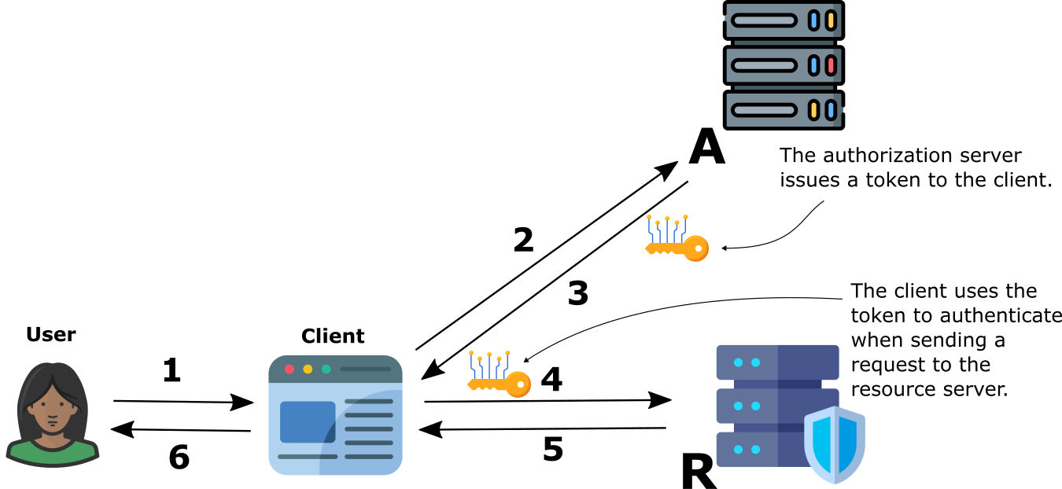
OpenID Connect / OAuth 2
Notes:
Elements (version 1)
Elements are used to give more detail to a set of ideas, they should all relate to the same topic.
For example, use this page for a list of deliverables, key roles on a project, phases of a project, or any topic that can be broken down into more specific examples.
Each section should have an icon that relates to the content of that specific element, no icon should be repeated on the same page, and they should all be the same colour.
Keep the text to 1-2 sentences and aim to have about the same amount of content under each element.

Slide 23
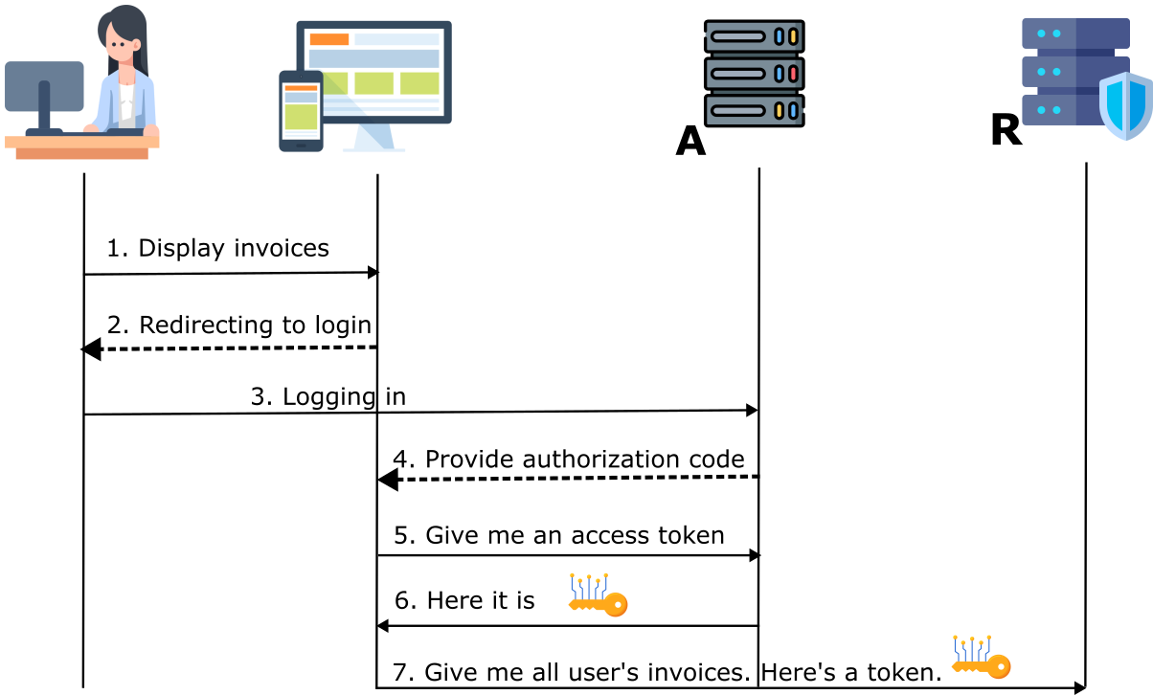
OpenID Connect / OAuth 2
Notes:
Elements (version 1)
Elements are used to give more detail to a set of ideas, they should all relate to the same topic.
For example, use this page for a list of deliverables, key roles on a project, phases of a project, or any topic that can be broken down into more specific examples.
Each section should have an icon that relates to the content of that specific element, no icon should be repeated on the same page, and they should all be the same colour.
Keep the text to 1-2 sentences and aim to have about the same amount of content under each element.

Slide 24
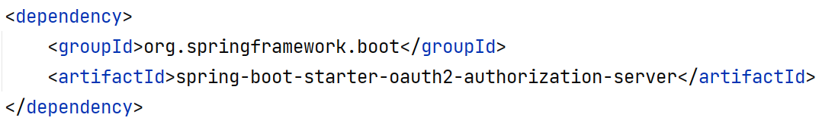
Notes:
Elements (version 1)
Elements are used to give more detail to a set of ideas, they should all relate to the same topic.
For example, use this page for a list of deliverables, key roles on a project, phases of a project, or any topic that can be broken down into more specific examples.
Each section should have an icon that relates to the content of that specific element, no icon should be repeated on the same page, and they should all be the same colour.
Keep the text to 1-2 sentences and aim to have about the same amount of content under each element.

Slide 25
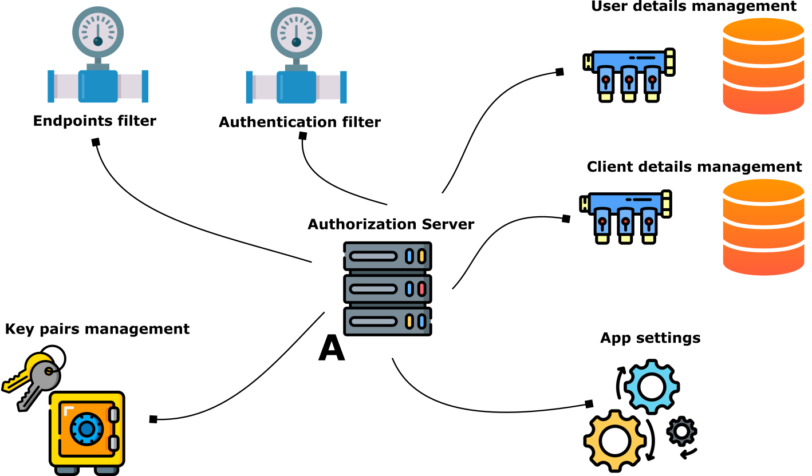
Notes:
Elements (version 1)
Elements are used to give more detail to a set of ideas, they should all relate to the same topic.
For example, use this page for a list of deliverables, key roles on a project, phases of a project, or any topic that can be broken down into more specific examples.
Each section should have an icon that relates to the content of that specific element, no icon should be repeated on the same page, and they should all be the same colour.
Keep the text to 1-2 sentences and aim to have about the same amount of content under each element.

Slide 26
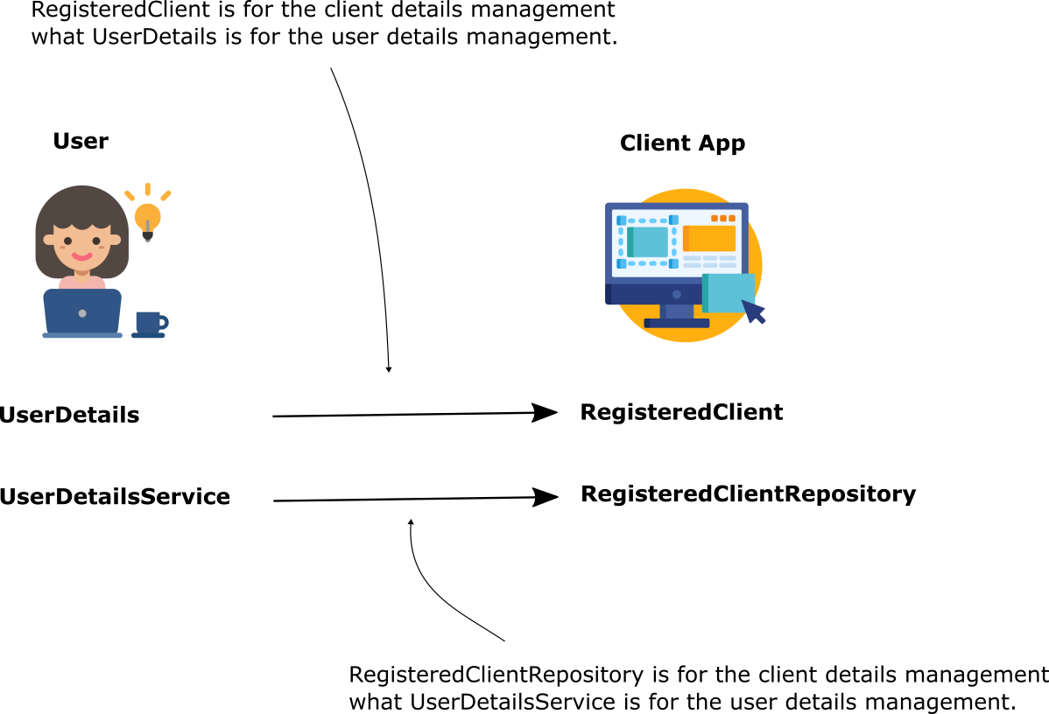
Notes:
Elements (version 1)
Elements are used to give more detail to a set of ideas, they should all relate to the same topic.
For example, use this page for a list of deliverables, key roles on a project, phases of a project, or any topic that can be broken down into more specific examples.
Each section should have an icon that relates to the content of that specific element, no icon should be repeated on the same page, and they should all be the same colour.
Keep the text to 1-2 sentences and aim to have about the same amount of content under each element.

Slide 27
http://localhost:8080/oauth2/authorize?response_type=code&client_id=client&scope=openid&redirect_uri=https://devoxx.be/authorized&code_challenge=QYPAZ5NU8yvtlQ9erXrUYR-T5AGCjCF47vN-KsaI2A8&code_challenge_method=S256
http://localhost:8080/oauth2/authorize?response_type=code&client_id=client&scope=openid&redirect_uri=https://devoxx.be/authorized&code_challenge=QYPAZ5NU8yvtlQ9erXrUYR-T5AGCjCF47vN-KsaI2A8&code_challenge_method=S256
http://localhost:8080/.well-known/openid-configuration
Notes:
Elements (version 1)
Elements are used to give more detail to a set of ideas, they should all relate to the same topic.
For example, use this page for a list of deliverables, key roles on a project, phases of a project, or any topic that can be broken down into more specific examples.
Each section should have an icon that relates to the content of that specific element, no icon should be repeated on the same page, and they should all be the same colour.
Keep the text to 1-2 sentences and aim to have about the same amount of content under each element.

Slide 28
http://localhost:8080/oauth2/authorize?
response_type=code&
client_id=client&
scope=openid&
redirect_uri=https://devoxx.be/authorized&
code_challenge=QYPAZ5NU8yvtlQ9erXrUYR-T5…
code_challenge_method=S256
http://localhost:8080/oauth2/authorize?response_type=code&client_id=client&scope=openid&redirect_uri=https://devoxx.be/authorized&code_challenge=QYPAZ5NU8yvtlQ9erXrUYR-T5AGCjCF47vN-KsaI2A8&code_challenge_method=S256
http://localhost:8080/oauth2/authorize?response_type=code&client_id=client&scope=openid&redirect_uri=https://devoxx.be/authorized&code_challenge=QYPAZ5NU8yvtlQ9erXrUYR-T5AGCjCF47vN-KsaI2A8&code_challenge_method=S256
Notes:
Elements (version 1)
Elements are used to give more detail to a set of ideas, they should all relate to the same topic.
For example, use this page for a list of deliverables, key roles on a project, phases of a project, or any topic that can be broken down into more specific examples.
Each section should have an icon that relates to the content of that specific element, no icon should be repeated on the same page, and they should all be the same colour.
Keep the text to 1-2 sentences and aim to have about the same amount of content under each element.

Slide 29
http://localhost:8080/oauth2/token?
client_id=client&
redirect_uri=https://devoxx.be/authorized&
grant_type=authorization_code&
code=IhKRpq7GJ7P5VQI_...&
code_verifier=qPsH306-ZDDaOE8DFzVn05TkN3…
Notes:
Elements (version 1)
Elements are used to give more detail to a set of ideas, they should all relate to the same topic.
For example, use this page for a list of deliverables, key roles on a project, phases of a project, or any topic that can be broken down into more specific examples.
Each section should have an icon that relates to the content of that specific element, no icon should be repeated on the same page, and they should all be the same colour.
Keep the text to 1-2 sentences and aim to have about the same amount of content under each element.

Slide 30
Customizing tokens
Notes:
Elements (version 1)
Elements are used to give more detail to a set of ideas, they should all relate to the same topic.
For example, use this page for a list of deliverables, key roles on a project, phases of a project, or any topic that can be broken down into more specific examples.
Each section should have an icon that relates to the content of that specific element, no icon should be repeated on the same page, and they should all be the same colour.
Keep the text to 1-2 sentences and aim to have about the same amount of content under each element.

Slide 31
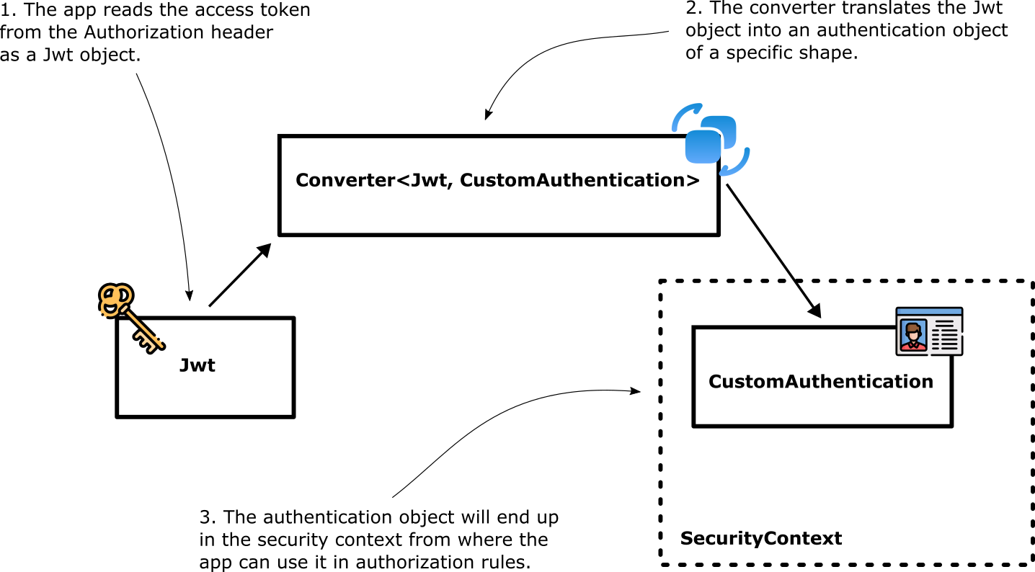
Notes:
Elements (version 1)
Elements are used to give more detail to a set of ideas, they should all relate to the same topic.
For example, use this page for a list of deliverables, key roles on a project, phases of a project, or any topic that can be broken down into more specific examples.
Each section should have an icon that relates to the content of that specific element, no icon should be repeated on the same page, and they should all be the same colour.
Keep the text to 1-2 sentences and aim to have about the same amount of content under each element.

Slide 32
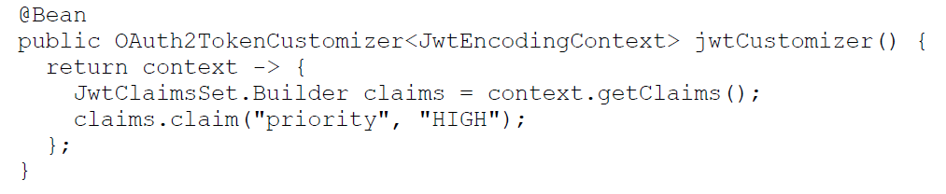
Notes:
Elements (version 1)
Elements are used to give more detail to a set of ideas, they should all relate to the same topic.
For example, use this page for a list of deliverables, key roles on a project, phases of a project, or any topic that can be broken down into more specific examples.
Each section should have an icon that relates to the content of that specific element, no icon should be repeated on the same page, and they should all be the same colour.
Keep the text to 1-2 sentences and aim to have about the same amount of content under each element.

Slide 33
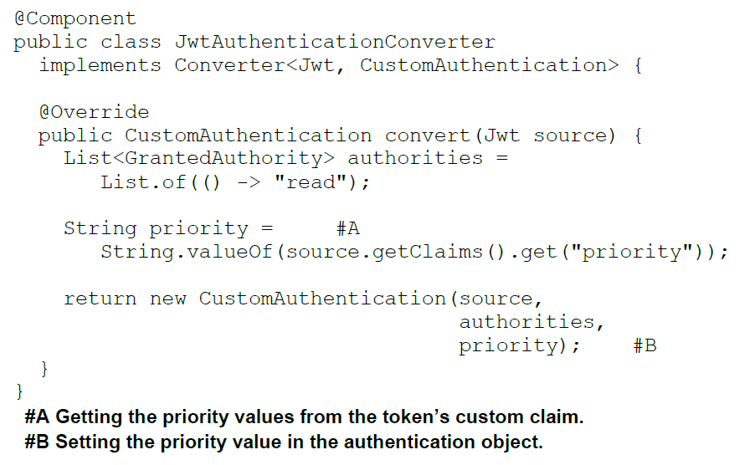
Notes:
Elements (version 1)
Elements are used to give more detail to a set of ideas, they should all relate to the same topic.
For example, use this page for a list of deliverables, key roles on a project, phases of a project, or any topic that can be broken down into more specific examples.
Each section should have an icon that relates to the content of that specific element, no icon should be repeated on the same page, and they should all be the same colour.
Keep the text to 1-2 sentences and aim to have about the same amount of content under each element.

Slide 34
Going opaque
Notes:
Elements (version 1)
Elements are used to give more detail to a set of ideas, they should all relate to the same topic.
For example, use this page for a list of deliverables, key roles on a project, phases of a project, or any topic that can be broken down into more specific examples.
Each section should have an icon that relates to the content of that specific element, no icon should be repeated on the same page, and they should all be the same colour.
Keep the text to 1-2 sentences and aim to have about the same amount of content under each element.

Slide 35
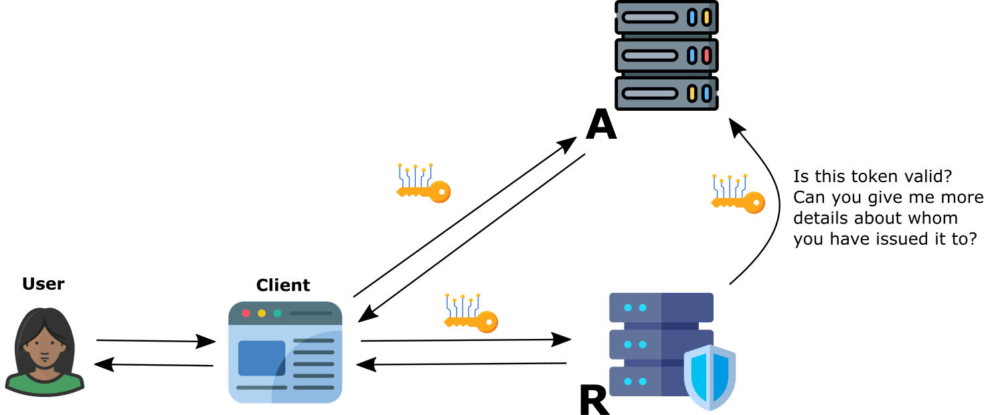
Notes:
Elements (version 1)
Elements are used to give more detail to a set of ideas, they should all relate to the same topic.
For example, use this page for a list of deliverables, key roles on a project, phases of a project, or any topic that can be broken down into more specific examples.
Each section should have an icon that relates to the content of that specific element, no icon should be repeated on the same page, and they should all be the same colour.
Keep the text to 1-2 sentences and aim to have about the same amount of content under each element.

Slide 36
Multitenancy
Notes:
Elements (version 1)
Elements are used to give more detail to a set of ideas, they should all relate to the same topic.
For example, use this page for a list of deliverables, key roles on a project, phases of a project, or any topic that can be broken down into more specific examples.
Each section should have an icon that relates to the content of that specific element, no icon should be repeated on the same page, and they should all be the same colour.
Keep the text to 1-2 sentences and aim to have about the same amount of content under each element.

Slide 37
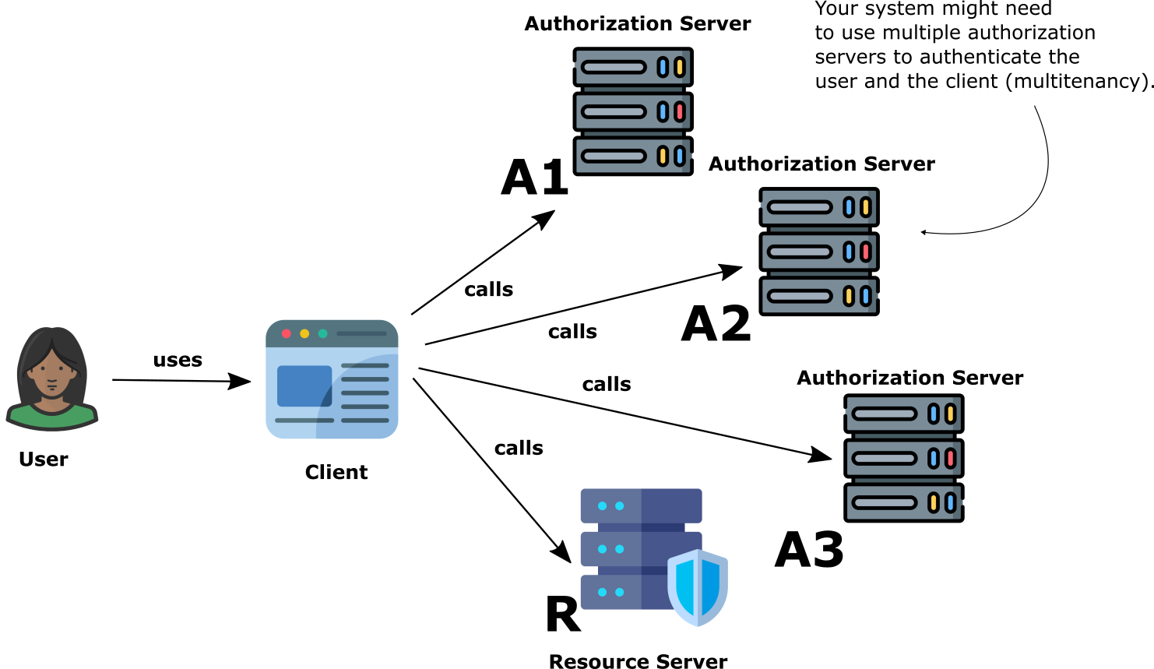
Notes:
Elements (version 1)
Elements are used to give more detail to a set of ideas, they should all relate to the same topic.
For example, use this page for a list of deliverables, key roles on a project, phases of a project, or any topic that can be broken down into more specific examples.
Each section should have an icon that relates to the content of that specific element, no icon should be repeated on the same page, and they should all be the same colour.
Keep the text to 1-2 sentences and aim to have about the same amount of content under each element.

Slide 38
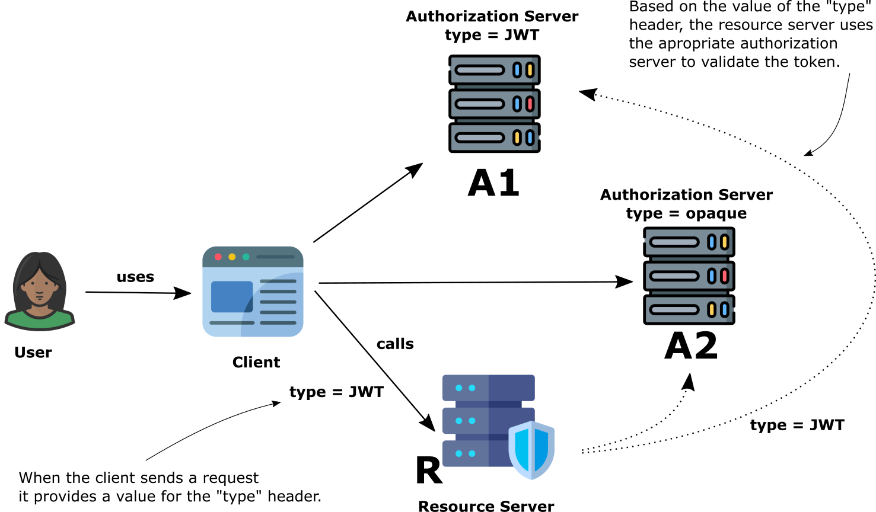
Notes:
Elements (version 1)
Elements are used to give more detail to a set of ideas, they should all relate to the same topic.
For example, use this page for a list of deliverables, key roles on a project, phases of a project, or any topic that can be broken down into more specific examples.
Each section should have an icon that relates to the content of that specific element, no icon should be repeated on the same page, and they should all be the same colour.
Keep the text to 1-2 sentences and aim to have about the same amount of content under each element.

Slide 39
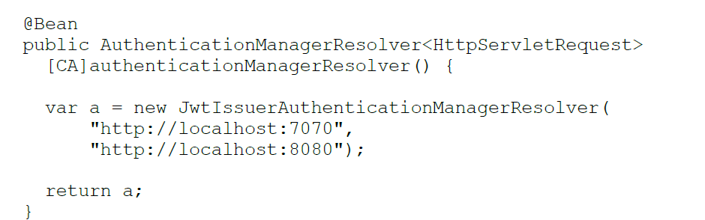
Notes:
Elements (version 1)
Elements are used to give more detail to a set of ideas, they should all relate to the same topic.
For example, use this page for a list of deliverables, key roles on a project, phases of a project, or any topic that can be broken down into more specific examples.
Each section should have an icon that relates to the content of that specific element, no icon should be repeated on the same page, and they should all be the same colour.
Keep the text to 1-2 sentences and aim to have about the same amount of content under each element.

Slide 40
What to next at #Devoxx?
Notes:
Elements (version 1)
Elements are used to give more detail to a set of ideas, they should all relate to the same topic.
For example, use this page for a list of deliverables, key roles on a project, phases of a project, or any topic that can be broken down into more specific examples.
Each section should have an icon that relates to the content of that specific element, no icon should be repeated on the same page, and they should all be the same colour.
Keep the text to 1-2 sentences and aim to have about the same amount of content under each element.

Slide 41
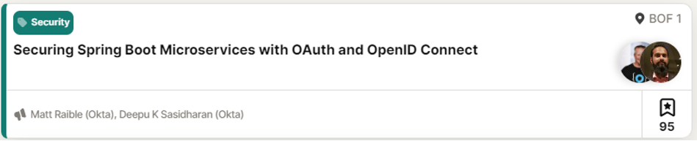
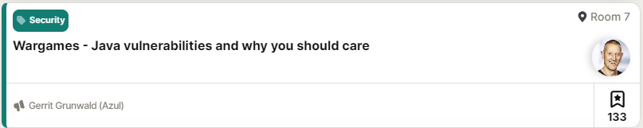
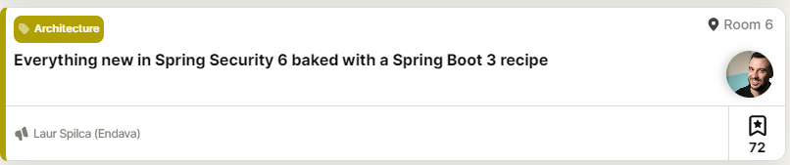
Notes:
Elements (version 1)
Elements are used to give more detail to a set of ideas, they should all relate to the same topic.
For example, use this page for a list of deliverables, key roles on a project, phases of a project, or any topic that can be broken down into more specific examples.
Each section should have an icon that relates to the content of that specific element, no icon should be repeated on the same page, and they should all be the same colour.
Keep the text to 1-2 sentences and aim to have about the same amount of content under each element.

Slide 42
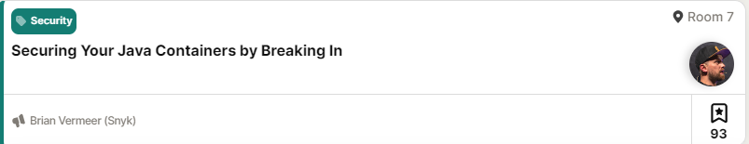
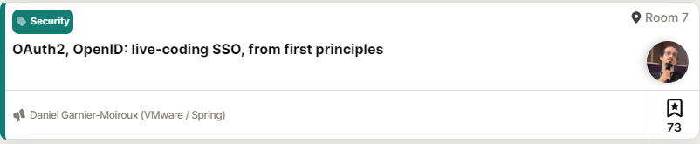
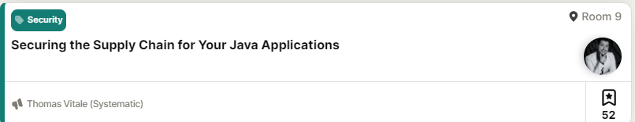
Notes:
Elements (version 1)
Elements are used to give more detail to a set of ideas, they should all relate to the same topic.
For example, use this page for a list of deliverables, key roles on a project, phases of a project, or any topic that can be broken down into more specific examples.
Each section should have an icon that relates to the content of that specific element, no icon should be repeated on the same page, and they should all be the same colour.
Keep the text to 1-2 sentences and aim to have about the same amount of content under each element.

Slide 43
laurspilca.com/blog
youtube.com/c/laurentiuspilca
@laurspilca
Laurentiu Spilca
Notes:
Elements (version 1)
Elements are used to give more detail to a set of ideas, they should all relate to the same topic.
For example, use this page for a list of deliverables, key roles on a project, phases of a project, or any topic that can be broken down into more specific examples.
Each section should have an icon that relates to the content of that specific element, no icon should be repeated on the same page, and they should all be the same colour.
Keep the text to 1-2 sentences and aim to have about the same amount of content under each element.

Slide 44
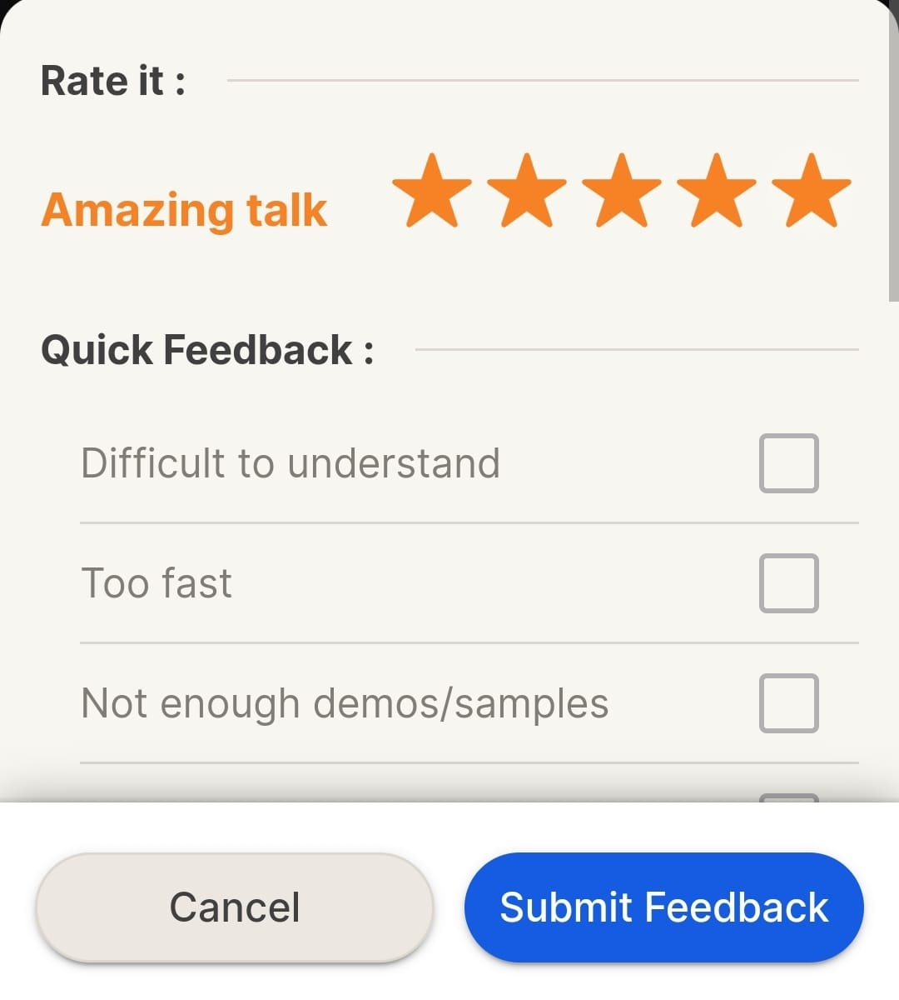

https://github.com/lspil/devoxxbe2023
Notes:
Elements (version 1)
Elements are used to give more detail to a set of ideas, they should all relate to the same topic.
For example, use this page for a list of deliverables, key roles on a project, phases of a project, or any topic that can be broken down into more specific examples.
Each section should have an icon that relates to the content of that specific element, no icon should be repeated on the same page, and they should all be the same colour.
Keep the text to 1-2 sentences and aim to have about the same amount of content under each element.

